Slide 1
MANUAL MUSCLE TESTING
Dr. Goutami Katage Shah
Dept. Of Musculoskeletal Physiotherapy
MGM Institute Of Physiotherapy
Chh. Sambhajinagar

Slide 2
Introduction
Definition
Principles of MMT
Purpose and uses of MMT
Grades of MMT
Indications
Contraindications
Precautions and limitations

Slide 3
INTRODUCTION
1.Muscle testing is an integral part of physical examination . It provides information that is useful in differential diagnosis, prognosis and treatment of neuromuscular and musculoskeletal disorders.
2. MMT is used to determine the capability of muscles or muscle groups to function in movement and their ability to provide stability and support.
3. Manual muscle testing is used to determine the extent and

Slide 4
degree of muscular weakness resulting from disease, injury or disuse. The records obtained from these tests provide a base for planning therapeutic procedures and periodic re-testing. Muscle testing is an important tool for all members of health team.
4. Originators – Wilhelmine Wright and Robert W. Lovett, MD Professors of Orthopedic surgery.
5. The first comprehensive text was written by Lucille Daniels, Catherine Worthingham.
6. The Kendalls developed and published work on muscle testing, one of the more remarkable sagas in Physiotherapy.

Slide 5
WHAT IS
STRENGTH
POWER
ENDURANCE

Slide 6
RANGE OF MUSCLE WORK:
The full range in which a muscle work refers to the muscle, changing from a position of full stretch and contracting to a position of maximal shortening.
The full range is divided into three parts:
1. Outer range: From a position where the muscle is fully stretched to a position halfway through the full range of motion.
2. Inner range: From a position halfway through the full range of motion to a position where the muscle is fully shortened.
3. Middle range: The portion of the full range between the mid-point of the outer range and the midpoint of the inner range.

Slide 7
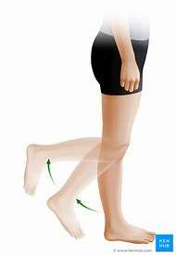
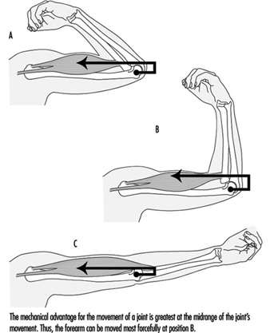

Slide 8
GROUP OF MUSCLE ACTION:
1. Prime mover or agonist:
A muscle or muscle group that makes the major contribution to movement at the joint.
2. Antagonist:
A muscle or a muscle group that has an opposite action to the prime movers. The antagonist relaxes as the agonist moves the part through a range of motion.
3. Synergist:
A muscle that contracts and works along with the agonist to produce the desired movement.

Slide 9
DEFINITION OF MMT:
Manual muscle test (MMT) is a procedure for the evaluation of strength of individual muscle or muscles group, based upon the effective performance of a movement in relation to the forces of gravity or Manual Resistance through the available Range of motion (ROM).
MMT is the most vital part of motor assessment .

Slide 10
Individual versus group muscle test:
Muscles with a common action or actions may be tested as a group or each muscle may be tested individually. For example, flexor carpi ulnaris and flexor carpi radialis muscles may be tested together as a group in wrist flexion. Flexor carpi ulnaris may be tested more specifically in the action of wrist flexion with ulnar deviation. On the other hand, Flexor carpi radialis longus and brevis may be tested more specifically in the action of wrist flexion with radial deviation

Slide 11
Purposes and uses of MMT:
CLINICAL USES :
i. The severity of problem can be understand. (It is diagnostic Tool)
ii. We can planning our treatment goals.
iii. Determine the extend & degree of muscular weakness resulting from disease, injury.
iv. Correlating muscle picture with in level innervations (myotomes) .
v. MMT is an Important tool for all the members of the Rehabilitation team.

Slide 12
vi. Help and Evaluate effectiveness of treatment to the therapist.

Slide 13
WHY MMT IS PERFORMED? :
To get some answers such as:-
i. Is a particular muscle is normal?
ii. Is it weak? (How much weak)
iii. Is it strong enough? (How much strong)
iv. Is it weak on both the side (bilateral symmetrical)?
v. Is it weak only on one side (Unilateral)?
vi. Is there any particular pattern of muscle weakness?

Slide 14
GRADES OF MMT:
i. MRC Scale
ii. OXFORD Scale
iii. KENDALL Scale
iv. And Others .

Slide 15
MRC GRADES | EXPLANATION
0 | NO CONTRACTION
1 | FLICKERING OF CONTRACTION
2 | FULL RANGE OF MOTION WITH ELIMINATED GRAVITY
3 | FULL RANGE OF MOTION AGAINST GRAVITY
4 | FULL RANGE OF MOTION AGAINST GRAVITY WITH MINIMAL RESISTANCE
5 | FULL RANGE OF MOTION AGAINST GRAVITY WITH MAXIMAL RESISTANCE

Slide 16
THE GRADING SYSTEM
Grades for MMT are recorded as ranging from 0-5.
THE BREAK TEST
Manual resistance is applied to a limb or other part when it has after it has completed range of motion or after it has been placed in end range by the therapist. The term resistance refers to concentric force that acts in opposition to a contracting muscle.
Resistance should be applied in the direction of “line of pull”
For eg of elbow flexion. The therapist applies resistance at

Slide 17
Wrist, trying to force the muscle to break its hold and move the forearm in downward elbow extension. And this procedure is most commonly used technique in MMT.
APPLICATION OF RESISTANCE
In MMT, external force is applied at end of the range for one-joint muscle. Two joint muscles are typically tested in mid range where length tension is more favorable.
Eg, One joint brachialis, quadriceps, hip abductors are tested at end range . Two joint gastrocnemius, quadriceps tested at mid range.

Slide 18
MAKE TEST
When resistance is applied throughout the range it is MAKE TEST.
INDICATIONS OF BREAK TEST:
1. When movement is contraindicated
2. When there is pain in movement
3. When we have to assess the quality of strength and not the quantity

Slide 19
AVAILABLE RANGE OF MOTION
1.In case of contracture or fixed joint limitation, there is limitation in joint range. The patient performs only within the available range. In this circumstance, the available range is the full range of motion of the motion even though it is not normal.
2. For example, the normal knee extension range is 135 degree to 0 degree. A patient with 20 deg knee flexion contracture is tested for knee extension strength at the available range or -20 deg range. If in sitting, it can complete in maximum resistance, the grade assigned is grade 5. If not then check for grade less than 3. Change the position.

Slide 20
SCREENING TEST:
A screen test is a method used to control muscle strength assessment, avoid unnecessary testing and avoid fatiguing and / or discouraging the patient.
Observation of the patient before the examination will provide valuable clues. Do the following
Observe the patient when he /she enters.
Observe the patient to sit and rise from chair, walk on toes, then on heels.
Ask patient to grip the hand .

Slide 21
4.The previous assessment of the patient's active range of motion.
5. Reading the patient's chart or previous muscle test result.
6. Observing the patient while performing functional activities. For example, shaking the patients hand may indicate the strength of grasp (finger flexors).
7. All muscle testing procedures must begin at a particular grade; this is usually grade “fair”. The patient is instructed to actively move the body part through full range of motion against gravity. Based upon the results of this initial test, the muscle test is either stopped or proceeds.

Slide 22
PRINCIPLES OF MMT
POSITION
PATIENT POSITION
It is important due to 2 aspects . First, the position of the body should permit function against gravity for all muscles in which gravity is a factor in grading. Second, the body should be placed in such a position that the parts not being tested will remain as stable as possible.
Patient is positioned Against gravity.
3. Do not change patient position repeatedly.
4. The patient should be as free as possible from discomfort or pain for the duration of each test.

Slide 23
JOINT POSITION:
The joint position is also changed depend upon their performance.
1.Distal part of the joint is moved.
2. Place the joint in Antigravity position- Grade 3

Slide 25
FIXATION
This refers to firmness or stability of body or body part, which is necessary to ensure an accurate test. Stabilization( holding steady), support, counterpressure( equal and opposite pressure) are all included under fixation which implies firm holding.
Adequate fixation depends on firmness of examining table. In some cases body weight furnish fixation e.g. supine, prone, sidelying.
3. In some cases, muscle furnish fixation. Eg the muscles that

Slide 26
Stabilize the scapula during arm movements and pelvis during leg movements. They do not directly enter into the test movement but they do stabilize the movable scapula or pelvis.
HAND PLACEMENT:
I. PROXIMAL HAND – At Origin of muscle & proximal joint giving stabilization.
II. DISTAL HAND – Distally offering resistance

Slide 28
STRENGTH TESTING
In muscle testing, weakness must be distinguished from restriction of ROM. Frequently, a muscle cannot complete the normal ROM. It may be due to the muscle is too weak that cannot complete the movement or it may be due to shortness of muscles.
The examiner should passively carry the part through the ROM to determine whether any restriction exists.
If no restriction is present, then failure to hold the test position may interpret weakness.

Slide 29
TEST POSITION
It is the position in which the part is placed by the examiner and held(if possible) by the patient.
The optimal position is at the completion of range for one-joint muscles and for to or multijoin muscle is at the midrange of overall length.
As the effort is made to hold the test position, the ability or inability to hold the position against gravity is at once established.
If it fails to hold, the examiner check for below the grade.

Slide 30
TEST MOVEMENT
It is a movement of the part in a specified direction and through a specific arc of motion.
Test movement is used when testing the lateral flexors, upper abdominals, back extensors, quadratus lumborum, serratus anterior, gastrocnemius.
It is difficult for patient to assume exact position through verbal command. For accuracy, examiner should place the part precisely in desired position.

Slide 31
PRESSURE AND RESISTANCE
Pressure= external force that is applied by examiner to determine the strength.
The placement, direction and amount of pressure are important factors.
Pressure is specified as ‘against or in the direction of’.
Against refers to position of examiners hand in relation to patient; in direction of describes the direction of force applied directly opposite the line of pull of muscle.
4. The place at which the pressure is applied depends on muscle insertions. Pressure is applied at the distal part.
5. Long ever should be used as it gives mechanical advantage and allows more sensitive grading.

Slide 32
6. When hip abductors are tested, use long lever and hip adductors, use short lever to avoid strain on anteromedial area.
POINTS TO REMEMBER
Pressure must be applied gradually
Resistance is applied slowly & gradually.
Increasing or decreasing manual resistance.
Apply presence opposite to the line of pull (Grade 4,5)
Apply force distally.
Use long lever to applied resistance whenever it possible

Slide 33
DEMONSTRATION:
Demonstrate the desired movement.
Therapist demonstrate the application of movement or performance to the patient.
CHECKING NORMAL STRENGTH:
Therapist to check the strength of the muscle normal side first.
OBJECTIVITY:
Therapist ability to palpate and observe the tendon or muscle response in very weak muscles.

Slide 34
SUBSTITUTION
Substitution results from one or more muscles attempting to compensate for the lack of strength in another muscle or group of muscle.
Muscles that normally act together in movements may act in substitution. These includes fixation muscles, agonists, antagonists.
Substitution by fixation muscles occurs specifically in relation to the movements of shoulder joint and hip joint.

Slide 35
4. Muscles that move the scapula may produce a secondary movement of the arm, muscles that move the pelvis may produce secondary movement of the thigh. These substitution movements appear similar to but are not movements of the shoulder or hip joint.
5. True abduction of hip joint is accomplished by hip abductors with normal fixation by the lateral trunk muscles. When hip abductors are weak, apparent abduction may occur by the substitution action of lateral muscles. The pelvis is hiked up

Slide 36
laterally , the leg is raised but there is no true hip abduction occurs.
6. Antagonists may produce movements similar to test movements . If finger flexors are weak, action of wrist extensors may produce passive finger flexion by the tension placed on finger flexors.
7. Substitution by agonists results in either a movement of the part in the direction of the stronger agonist or a shift of the body in a way that favors the pull of that agonist. Eg , during gluteus test in side lying, the thigh will tend to flex if the tensor fascia

Slide 37
Latae is attempting to substitute for gluteus medius , or the trunk may rotate back so that the tensor fascia latae can hold a position that appears to be the desired test position.
8. For accurate muscle examination, no substitution should be permitted. The position or movement describes as the test should be done without shifting the body or turning the part. Such movements allow other muscles to substitute for weak or paralyzed muscle.

Slide 38
INDICATIONS OF MMT:
1)Lower Motor Neuron (LMN) Disease.
2) Some other Neurological (Neuromuscular )disease. Such as,
Multiple Sclerosis
Muscular dystrophy
Amyotropic Lateral Sclerosis
Myasthenia Gravis.
Guillian - barre syndrome (GBS), etc....
3) Musculoskeletal disorders.

Slide 39
CONTRAINDICATIONS OF MMT:
1) Cerebral Palsy
2) Cardio vascular disease / Brain injury
3) Dislocated/ unhealed fracture
4) Myositis ossifications
5) Parkinson’s disease
6) Pain
7) Inflammation /(inflammatory disease in muscles and or joints)
8) Severe cardiac & respiratory disease .

Slide 40
9) Subluxation joint
10) Hemophilia
11) Osteoporosis

Slide 41
LIMITATION OF MMT:
1) UMN LESIONS :
Spastic muscle have poor control from higher centers thus its better to go for voluntary control assessment rather than MMT.
2)RESTICTED ROM DUE TO TCD’S (Transcranial Doppler) :
TCD’s can give faulty interpretation about MMT, thus in case always mention about the MMT within available range along with Grade.
3) PRESENCE OF PAIN & SWELLING:
pain and swelling increases the intra articular tension causing irritation of joint and can affect the MMT result, thus in case always mention about presence of pain along with Grade.

Slide 42
UNDERSTANDING OF COMMANDS:
Paediatric Age group < 5 years
IQ
Higher functions.
STRENGTH Vs ENDURANCE:
MMT give knowledge about only the strength and not endurance.
SUBJECTIVITY

Slide 43
RELIABILITY: The reliability of MMT is of concern and it remains still an important diagnostic tool.
SENSITIVTY: MMT also lacks in sensitivity.
TESTER STRENGTH: Female assessor strength is less than male assessor.

Slide 44
PREPARING FOR THE MUSCLE TEST
Patient should be free from discomfort or pain.
The environment should non distracting.
The plinth or table should be firm.
Patient position
Loose clothing

Slide 45
INFLUENCE OF THE PATIENT ON TEST
True effort of the patient( desire to do well / to seem more impaired than the actually is the case.
Patients ability to understand the test( language barrier)
Depression of the patient
Cultural, social, gender issues.

Slide 46
USE OF MMT IN VARIOUS CLINICAL SETTINGS
Acute care facilities- in the form of isometric contraction
Acute Rehabilitation facilities
Long term facilities
The home health settings for geriatric home bound patient
Outpatient clinics
Wellness clinics

Slide 47
FACTORS AFFECTING STRENGTH:
1). Age:
A decrease in strength occurs with increasing age due to deterioration in muscle mass. Muscle fibers decrease in size and number; there is an increase in connective tissue and fat and the respiratory capacity of the muscle decreases.
Strength apparently increases for the first 20 years of life, remains at this level for 5 or 10 years and then gradually decreases throughout the rest of life. The changes in muscular strength by aging are different for different groups of muscles. The progressive decrease in strength is clearer in the forearm flexors and muscles that raise the body (anti-gravity muscles).

Slide 48
2) Gender
Males are generally stronger than females. The strength of males increases rapidly from 2 to 19 years of age at a rate similar to weight and more slowly and regularly up to 30 years. After that, it declines at an increased rate to the age of 60 years. The strength of females is found to increase at a more uniform rate from 9 to 19 years and more slowly to 30 years, after which it falls off in a manner similar to males. It has been found that women are more 28 to 30% weaker than men at 40 to 45 years of age.

Slide 49
4). Muscle size:
The larger the cross-sectional area of a muscle, the greater the strength of this muscle will be. When testing a muscle that is small, the therapist would expect less tension to be developed rather than if testing a large, thick muscle.
5). Previous training effect:
Strength performance depends up on the ability of the nervous system to activate the muscle mass. Strength may increase as one becomes familiar with the test situation. The therapist must

Slide 50
instruct the patient well, giving him an opportunity to move or be passively moved through the test movement at least once before muscle strength is assessed.
Fatigue:
As the patient fatigues, muscle strength decreases. The therapist determines the strength of muscle using as few repetitions as possible to avoid fatigue. The patient's level of motivation, level of pain, body type, occupation and dominance are other factors that may affect strength.

Slide 51
OTHER WAYS TO ASSESS MUSCLE STRENGTH
INSTRUMENTATION
HANDHELD DYNAMOMETER
PINCH GUAGE
CABLE TENSIOMETER
FREE WEIGHT

Slide 52
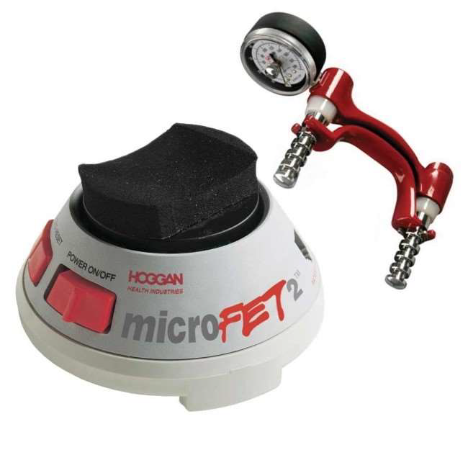
HAND HELD DYNAMOMETER:
This Device operate on Principle of compression. Application of external force to the dynamometer compress a steel spring and moves a pointer.

Slide 53
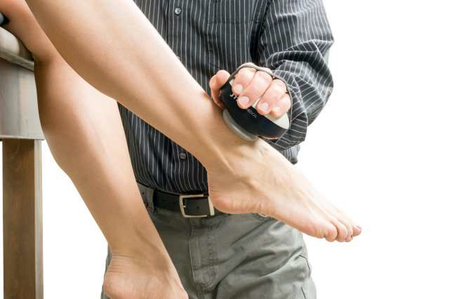
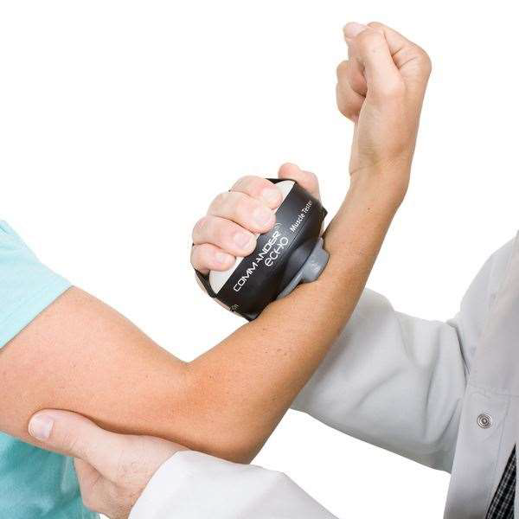

Slide 54
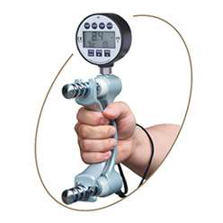
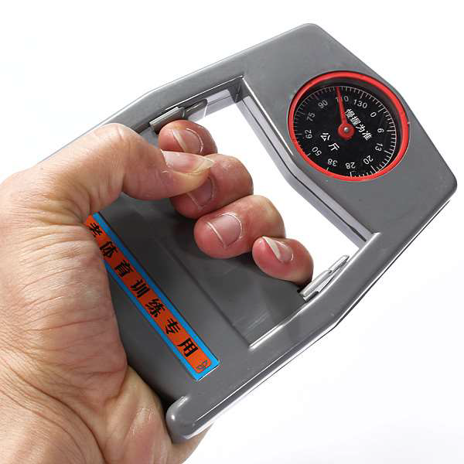

Slide 55
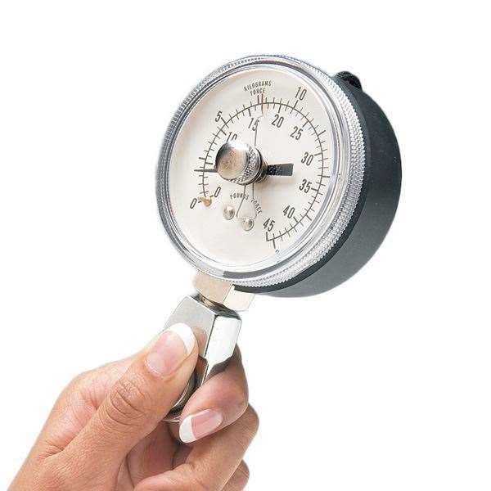
PINCH GAUGE:
pinch is a strength measurement using pinch dynamometer.

Slide 56
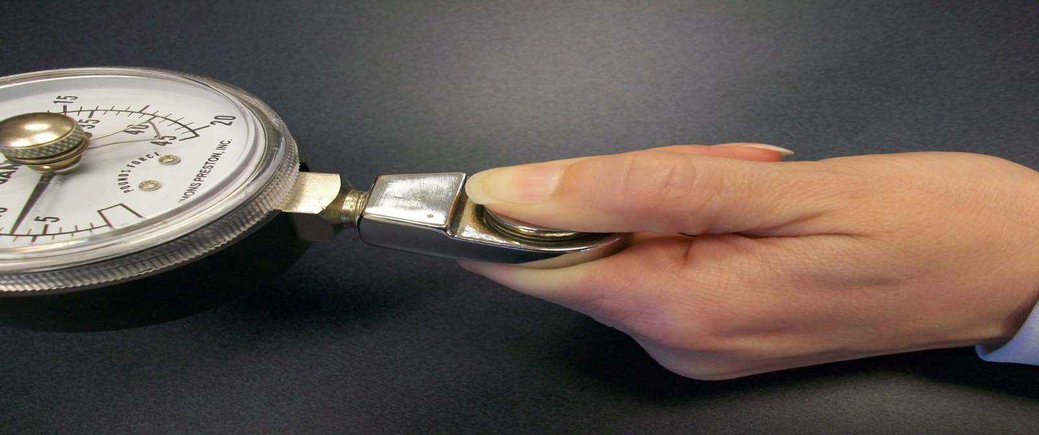

Slide 57
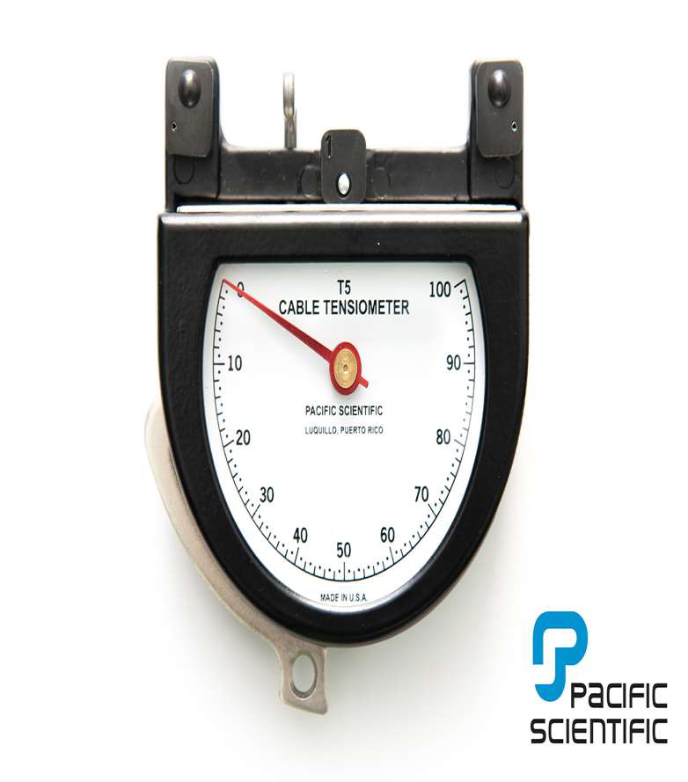
CABLE TENSIOMETER:
Force during knee extension increased force on cable depresses a riser over which cable passes, this deflects the pointer and indicates amount of force applied.

Slide 58
